Slide 1

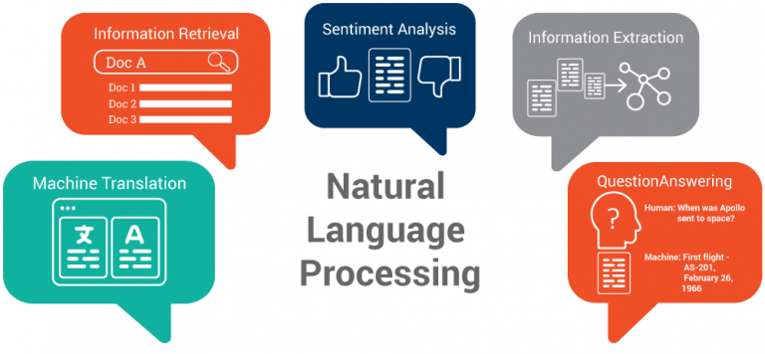
Copyright © www.ITbodhi.com

Slide 2
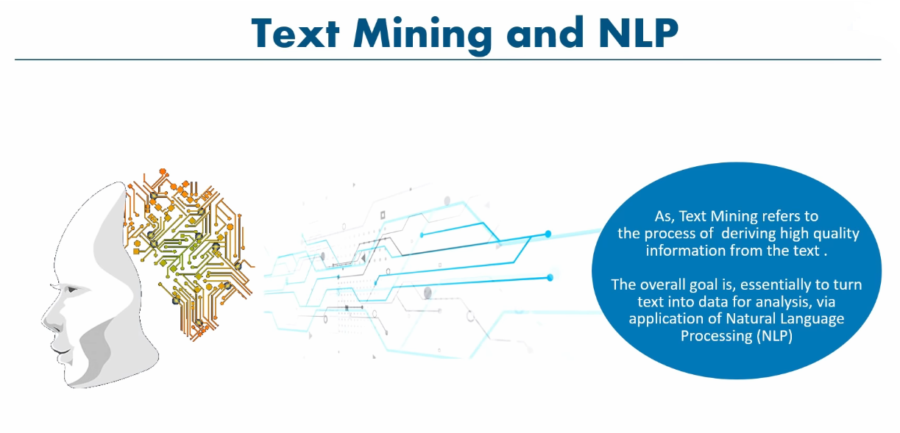
Copyright © www.ITbodhi.com

Slide 3
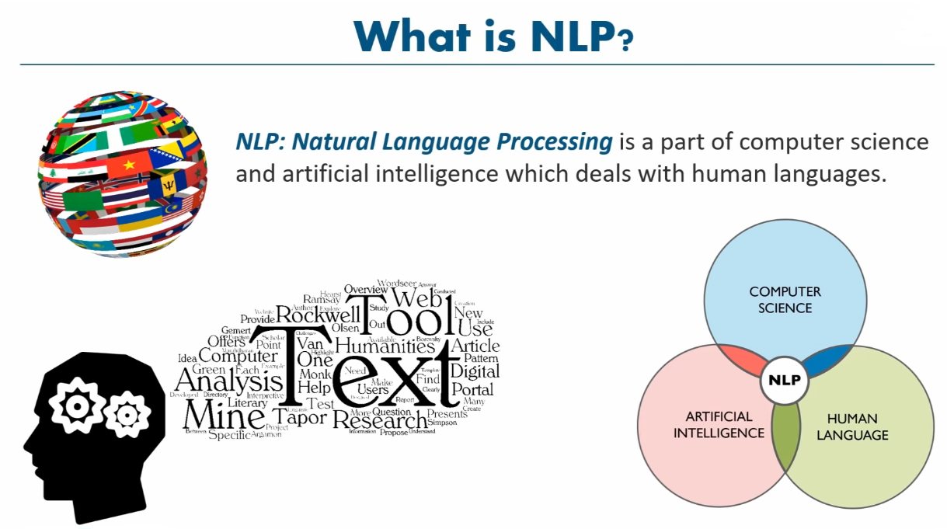
Copyright © www.ITbodhi.com

Slide 4
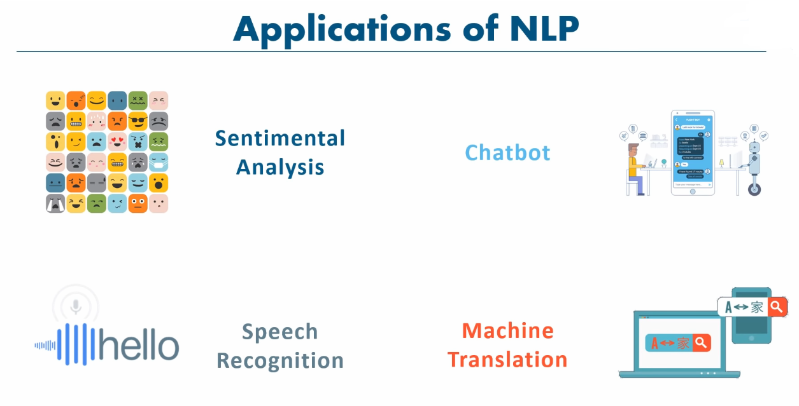
Copyright © www.ITbodhi.com

Slide 5
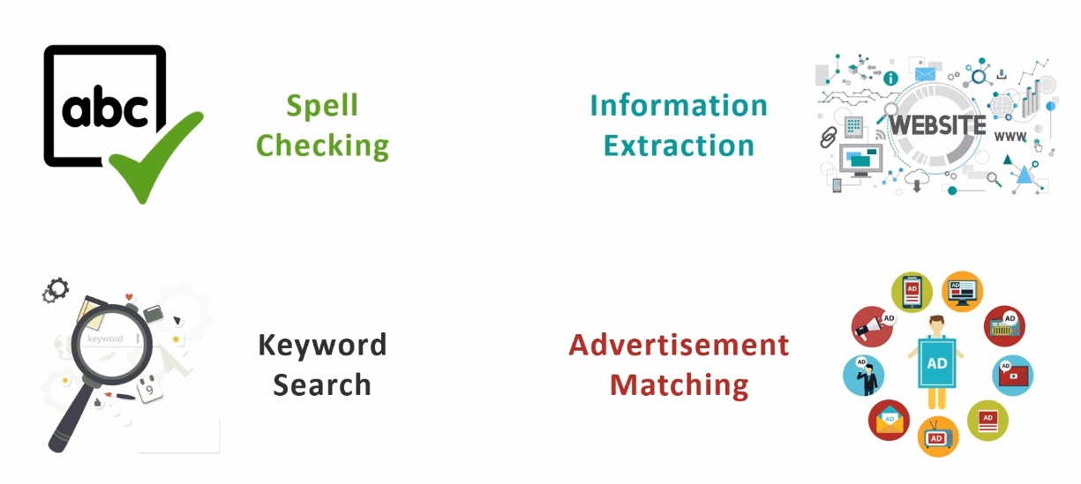
Copyright © www.ITbodhi.com

Slide 6
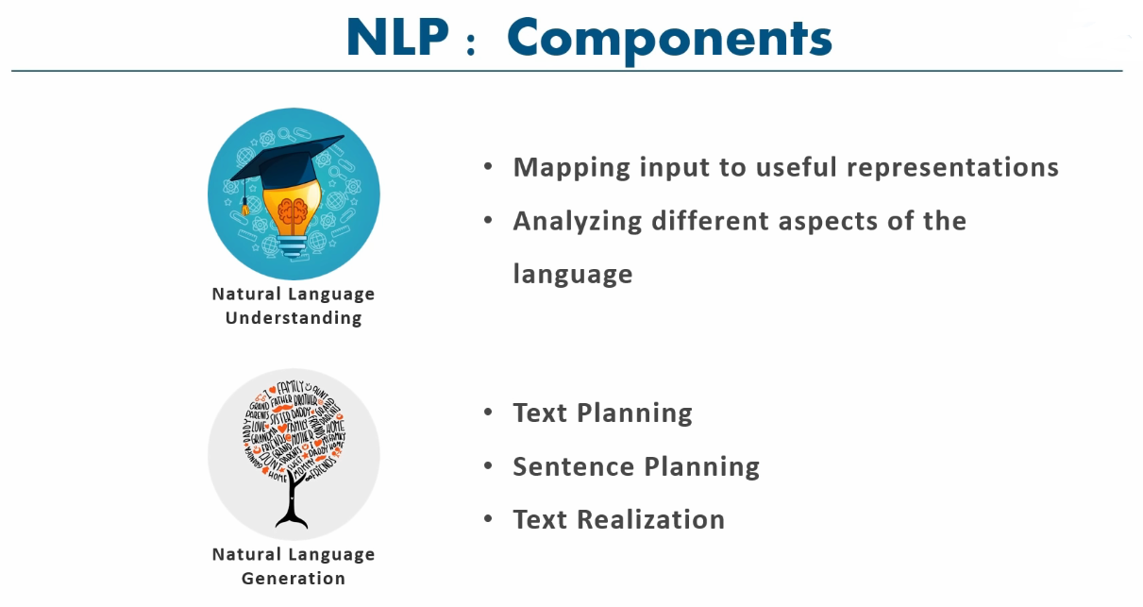
Copyright © www.ITbodhi.com

Slide 7
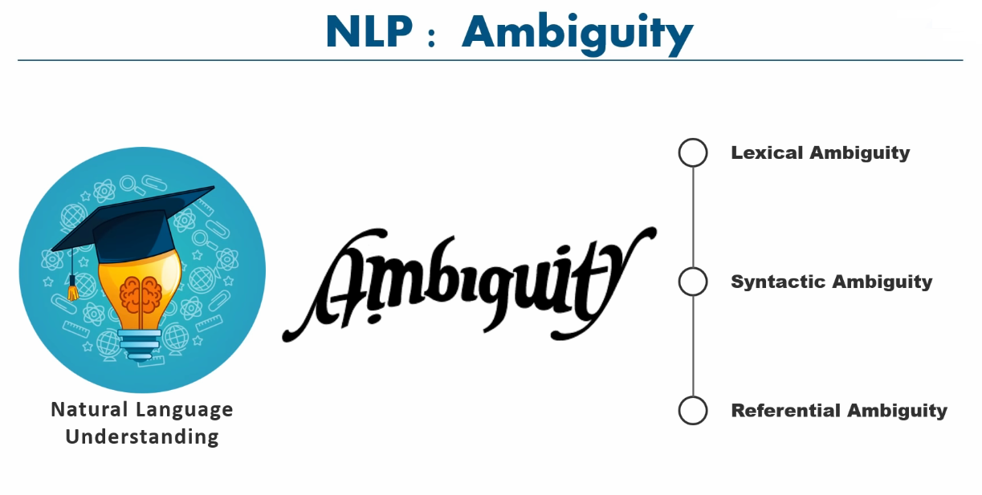
Copyright © www.ITbodhi.com

Slide 8
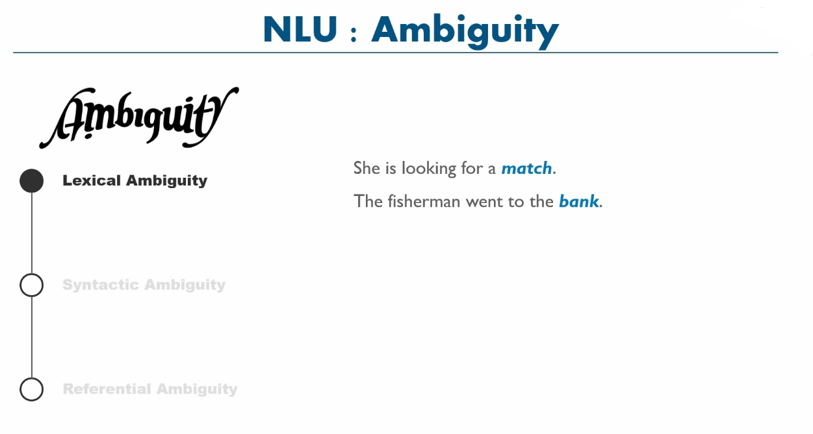
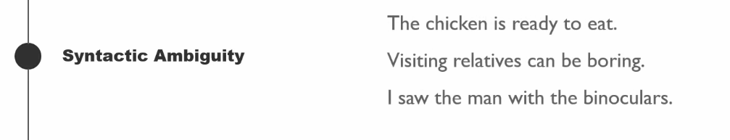
Copyright © www.ITbodhi.com

Slide 9
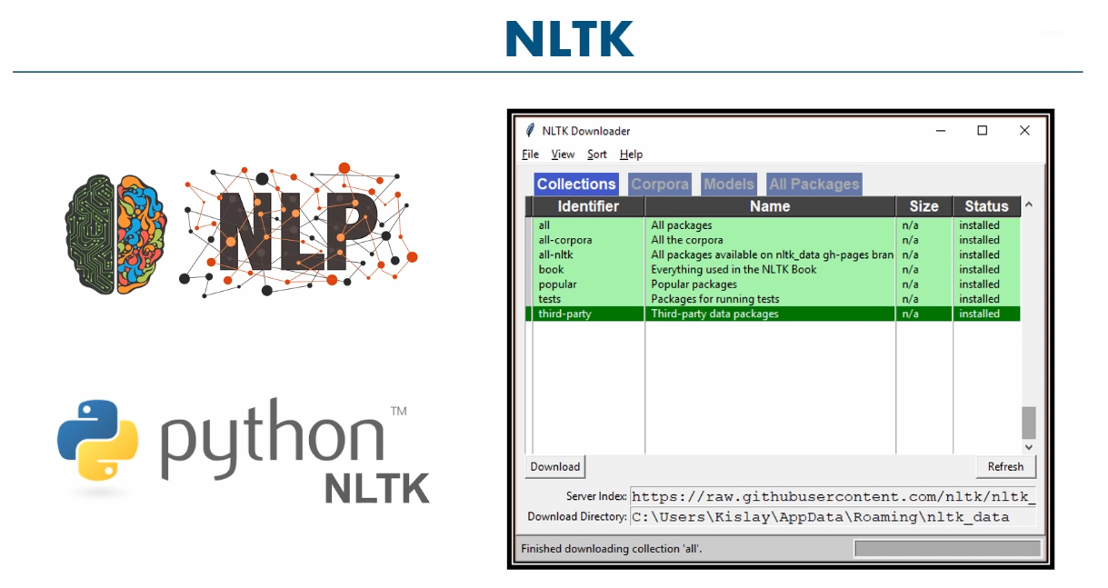
Copyright © www.ITbodhi.com

Slide 10
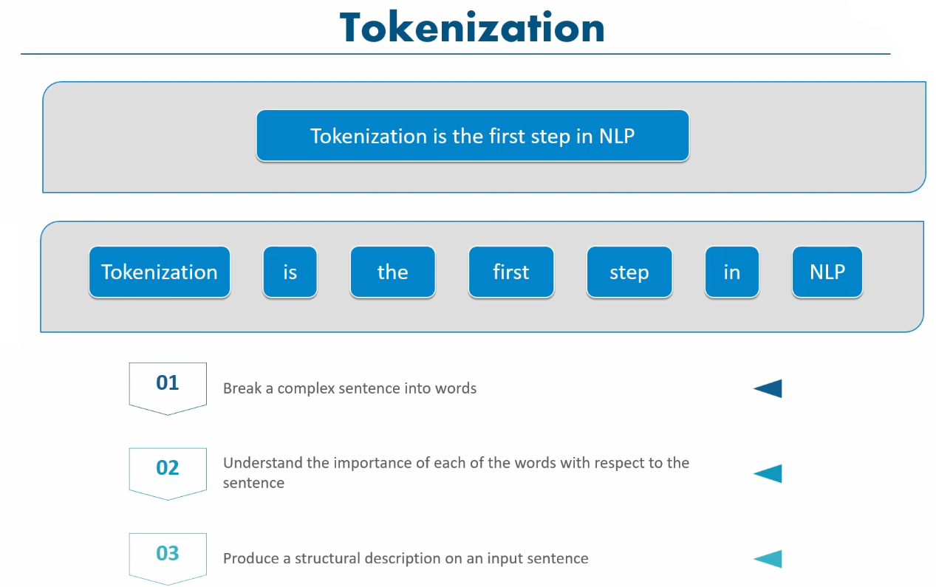
Copyright © www.ITbodhi.com

Slide 11
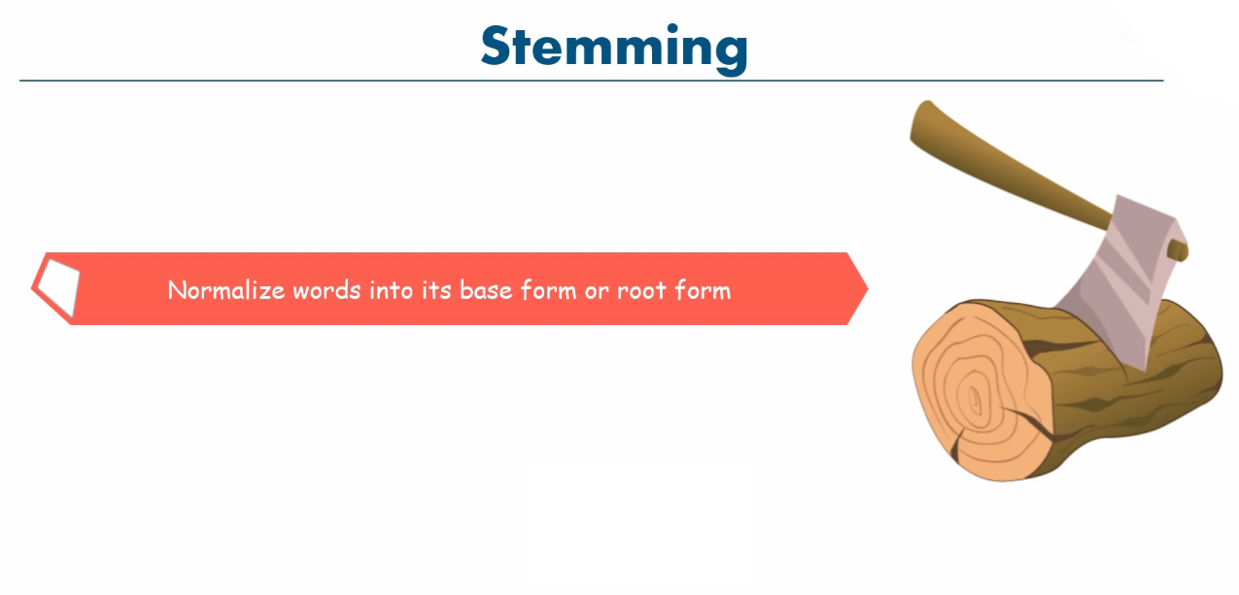
Copyright © www.ITbodhi.com

Slide 12
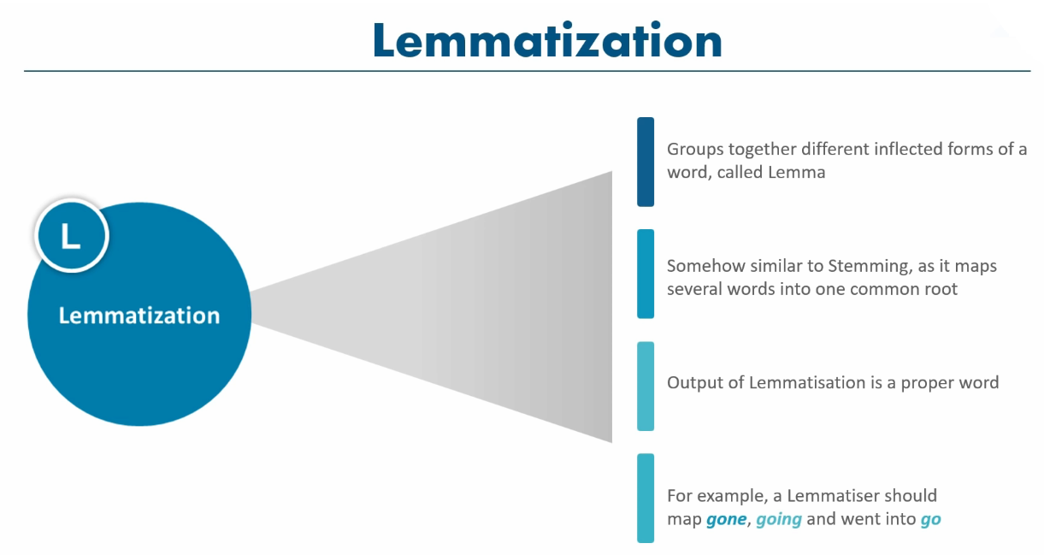
Copyright © www.ITbodhi.com

Slide 13
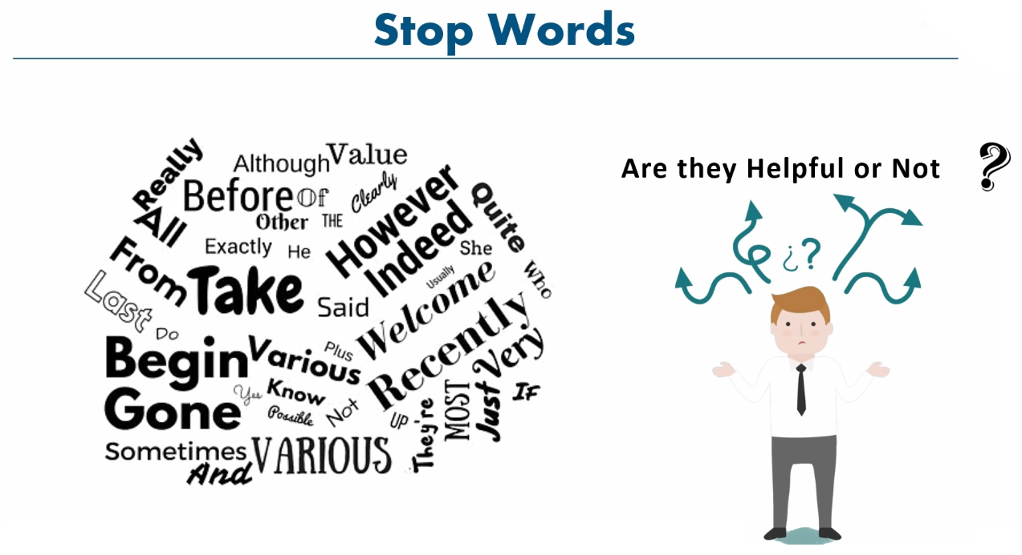
Copyright © www.ITbodhi.com

Slide 14
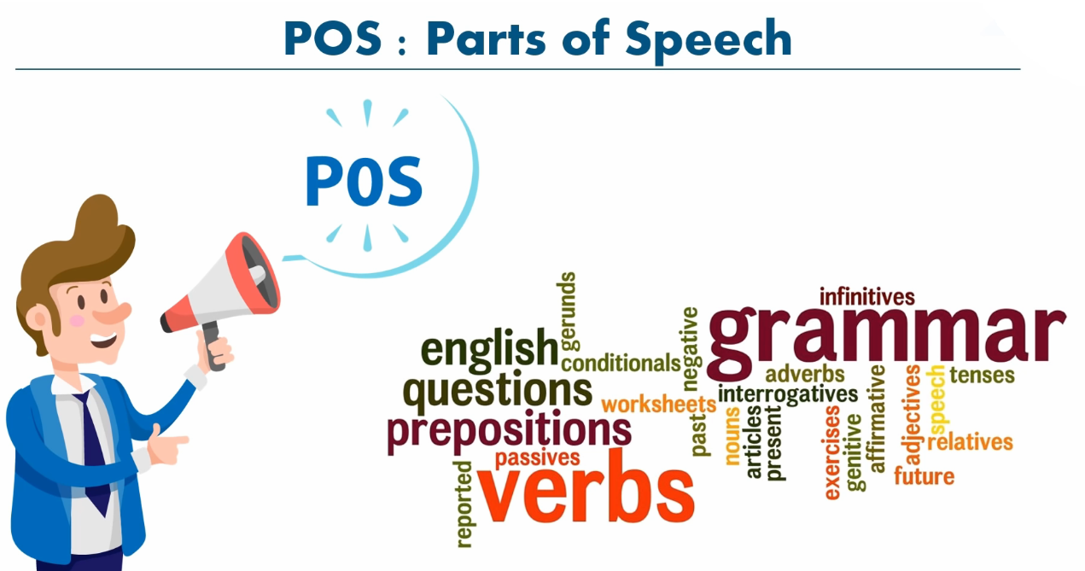
Copyright © www.ITbodhi.com

Slide 15
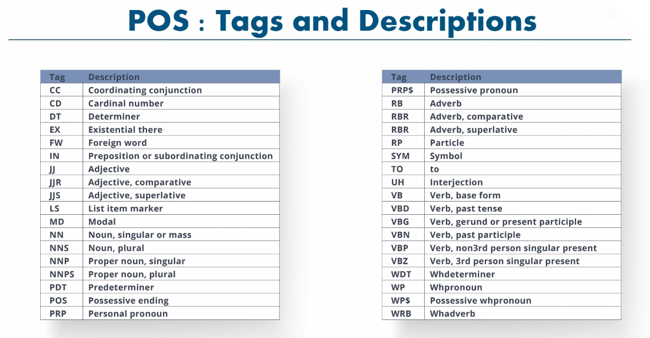
Copyright © www.ITbodhi.com

Slide 16
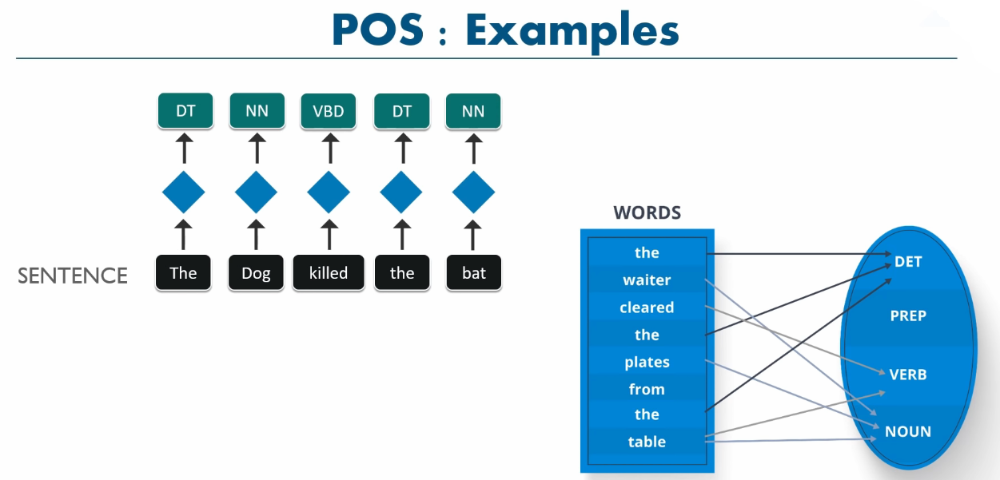
Copyright © www.ITbodhi.com

Slide 17
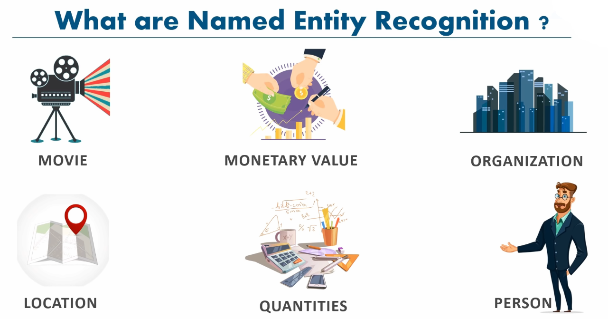
Copyright © www.ITbodhi.com

Slide 18
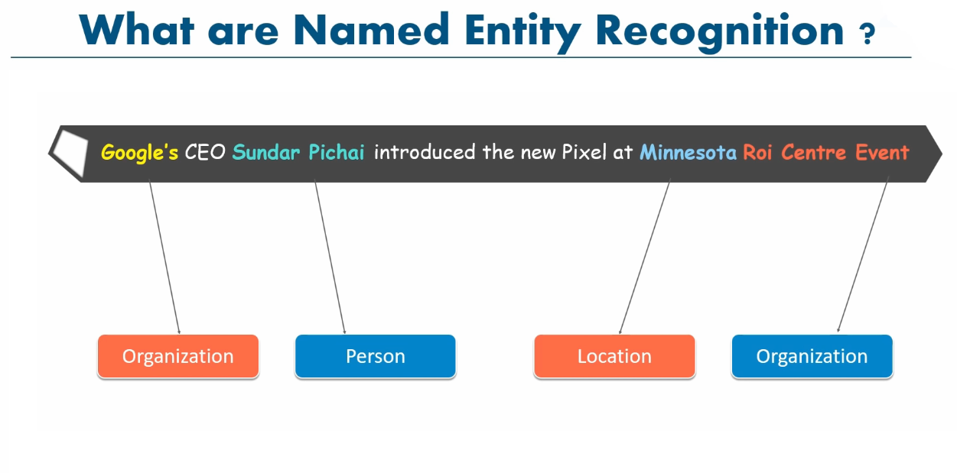
Copyright © www.ITbodhi.com

Slide 19
Additional considerations when cleaning text:
Handling large documents and large collections of text documents that do not fit into memory.
Extracting text from markup like HTML, PDF, or other structured document formats.
Transliteration of characters from other languages into English.
Decoding Unicode characters into a normalized form, such as UTF8.
Handling of domain specific words, phrases, and acronyms.
Handling or removing numbers, such as dates and amounts.
Locating and correcting common typos and misspellings.
……
Copyright © www.ITbodhi.com

Slide 20
TFIDF : Term frequency- inverse document frequency.
The TFIDF weight is used in text mining. The weight is a measure used to evaluate how important a word is to a document in a collection of documents.
When using a simple technique like a frequency table of the terms in the document, we remove stop words, punctuation and stem the word to its root. And then, the importance of the word is measured in terms of its frequency; higher the frequency, more important the word.
In case of TFIDF, the only text pre-processing is removing punctuation and lower casing the words. We do not have to worry about the stop words.
TFIDF is the product of the TF and IDF scores of the term.
TF = number of times the term appears in the doc/total number of words in the doc
IDF = ln(number of docs/number docs the term appears in)
Higher the TFIDF score, the rarer the term is and vice-versa.
TFIDF is successfully used by search engines like Google, as a ranking factor for content.
Copyright © www.ITbodhi.com

Slide 21
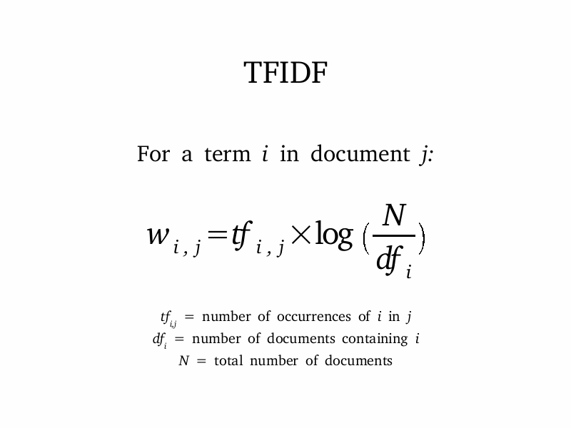
Copyright © www.ITbodhi.com

